Slide 1
The journey so far…
Luke Redfern
Regional Account Manager, Transport
Local Government Support Programme Lead
luke.redfern@est.org.uk

Slide 2
Who we are
An impartial organisation helping people to:
Save energy
Reduce carbon emissions
Use water sustainably
Directly supporting consumers to take action
Helping local authorities and communities to save energy, using our expert insight
Providing quality assurance for goods and services
Collaborating with national and international governments and organisations

Slide 3
What we do: EST transport
Independent
Impartial
Pragmatic
Help reduce fleet emissions
Accelerate EV transition
Promote fuel efficiency
Supporting charging infrastructure expansion
Help reduce freight, bus and taxi emissions
Share best practice and impartial guidance
Support local authorities
Notes:
English workplan by theme.
The majority of our services and advice is free, because we receive funding from DfT. And EST is impartial and pragmatic. Similar services in Scotland, funded by Transport Scotland
Add or delete services depending on your audience, the diagram should update

Slide 4
Drivers

Slide 5
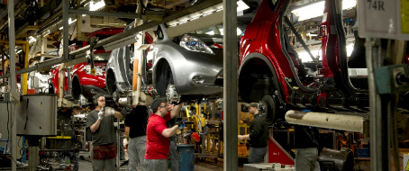
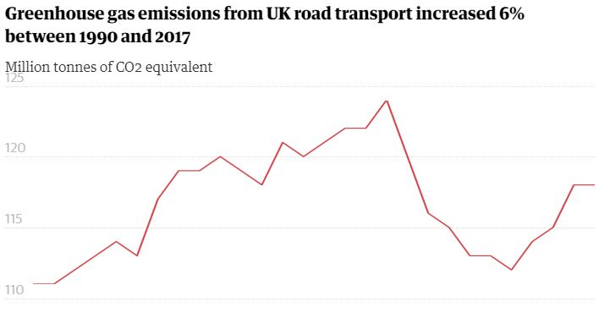
Drivers of Low Emission Vehicle Policy
Inward Investment
Carbon
Air Quality
Energy Security

Slide 6
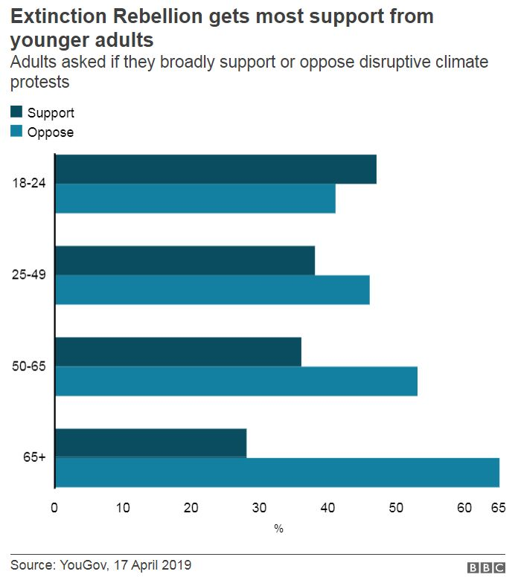
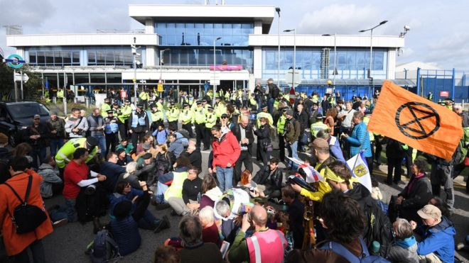
Growing Public Concern

Slide 7
The chargepoint journey
A three step model for businesses and local authorities…

Slide 8
Stage One…

Slide 9
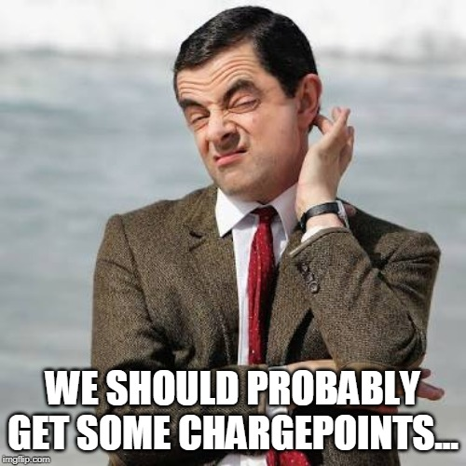
Stage Two…

Slide 10
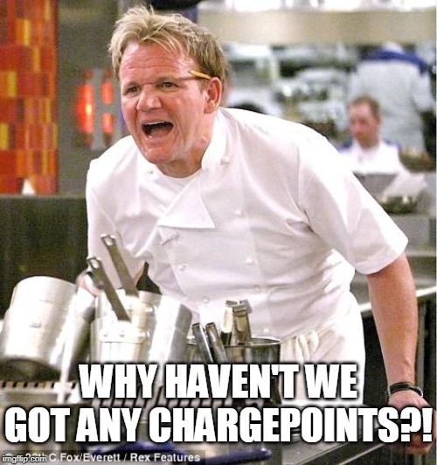
Stage Three…

Slide 11
Growth in infrastructure
2012
2019
According to Zap-Map, there are 28,034 connectors, 16,267 devices and 10,164 locations for charging infrastructure as stated on the 7 November 2019.
Previously saw a move from ‘range anxiety’ to ‘charging anxiety’; how long will I need to queue to get access to a charge point?
Battery range is increasing, so will this be a problem?
Current trend is on ‘experience anxiety’; will the chargepoint be working, can I access it, does it work?
Notes:
911 new connectors in 30 days

Slide 12
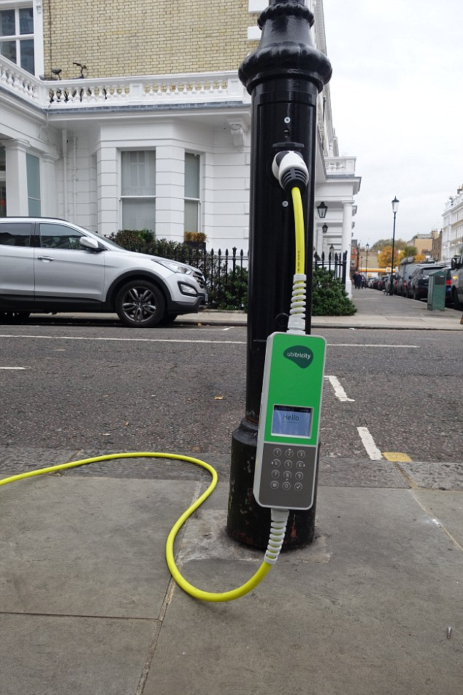
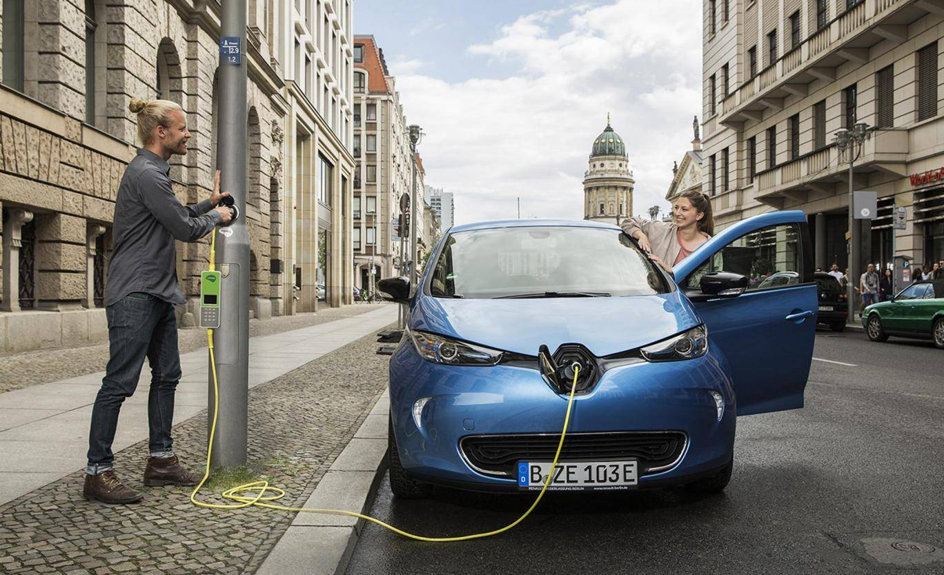
© Cenex

Slide 13
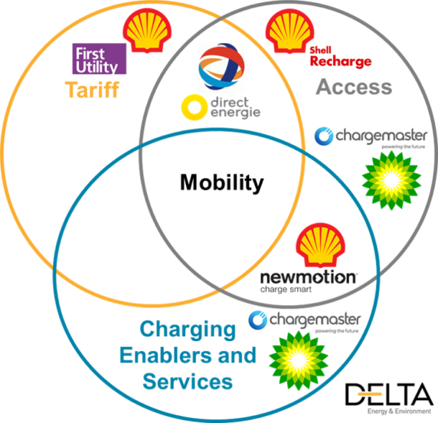
Diversification of Oil – A race to Dominate?
Acquisition is another clear signal that even the oil majors see the ICE vehicle becoming challenged.
Aiming to protect and monetise their existing fuels retailing assets through the development of their EV charging activities; whether they can build the scale they will desire without becoming significant players in the home charging market remains to be seen.
Source:
Notes:
The industry is only going to become more commercial – will non-profitable sites drop off?
Oil majors are purchasing chargepoints assets as they see ICE becoming challenged. Will authorities need to invest if private sector accelerate uptake, or will they just need to fill the gaps (e.g. residential).
Danger for them is the lack of break into the domestic market, one that they are not used to.

Slide 14
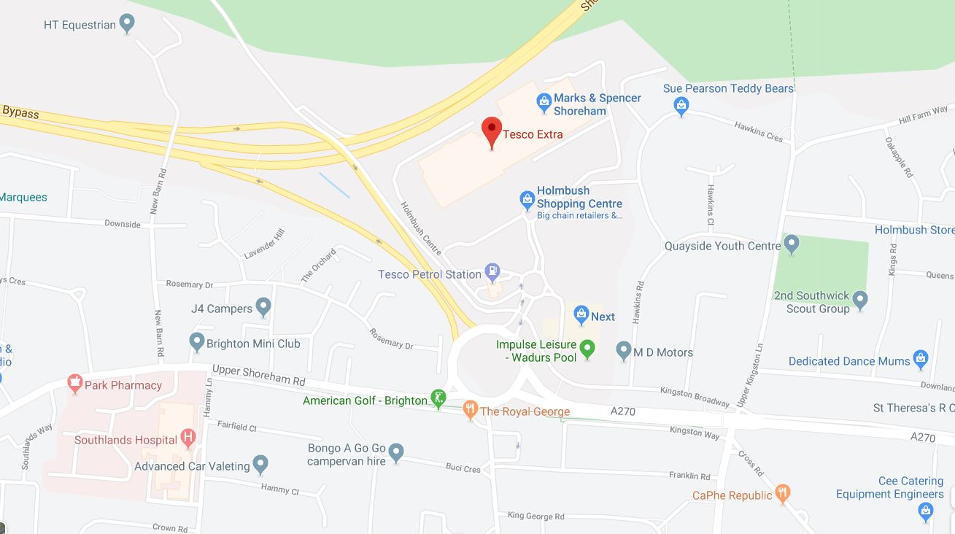
Consumers want clarity and connectivity…
Network C –
Supermarket:
£↑ - Rapid
£ 0 - Fast
£ 0 - Parking
Network D –
Community Centre:
£↓ - Slow (Residential)
Network B –
Hospital:
£↑ - Fast
£↑ - Parking
Network A –
Council Car Park:
£↓ - Fast
£↓ - Parking

Slide 15
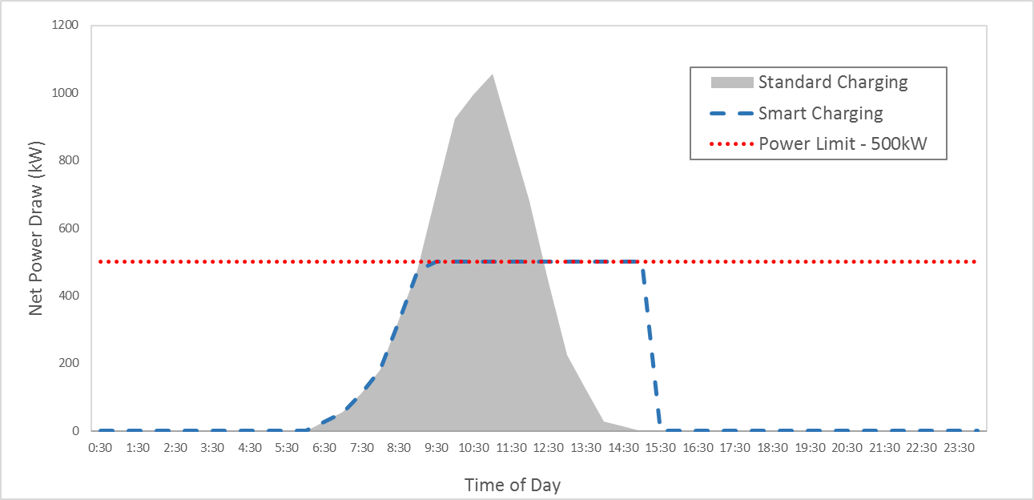
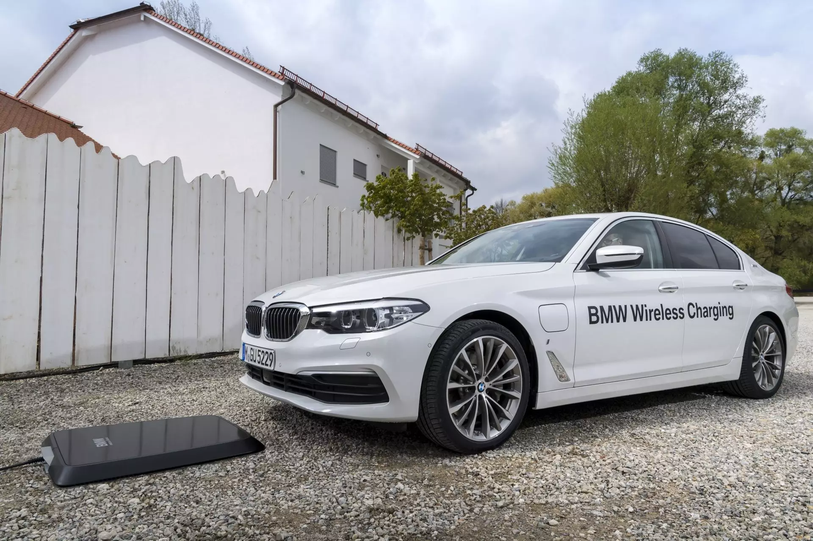
Trends consumers know (and ask) about…

Slide 16
A shift in focus?
Energy for Transport
Future Cities

Slide 17
How to deliver a “SAFE” chargepoint project
Sustainable
Analysed
Future-Proofed
Enforced

Slide 18
Conclusion
We understand the drivers; they haven’t gone away.
Consumers want clarity and connectivity.
We need to think smarter.
Let’s help people avoid turning into Gordon Ramsay…

Slide 19
Thank you for listening
Luke Redfern
Regional Account Manager, Transport
Local Government Support Programme Lead
luke.redfern@est.org.uk

